Slide 1
ECE 554 Lab 1 Start Guide

Slide 2
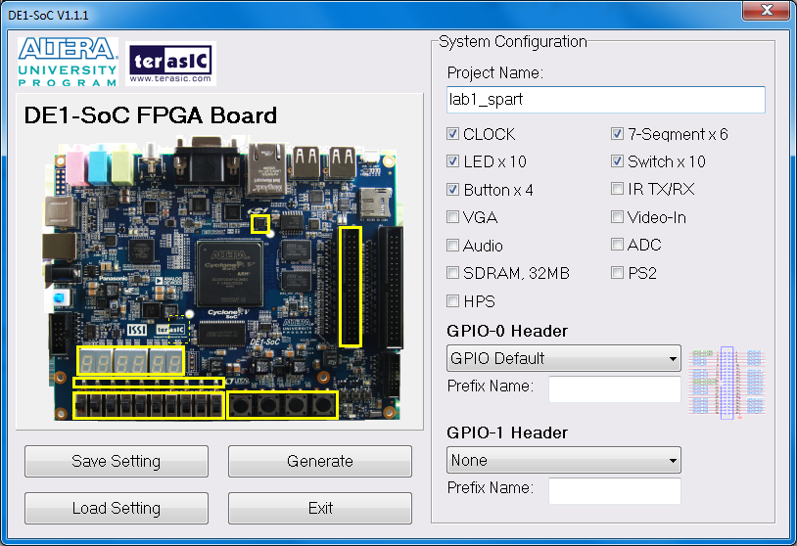
Generate project file using system builder
Set project name to “lab1_spart”
Select
clock
LED
Button
7-segqment
Switch
Set GPIO-0 to
GPIO Default

Slide 3
Copy to your own folder
Copy the generated project files to your own folder
Copy “lab1_spart.v” from the starter kit into your project folder
Look through lab1_spart.v to see what board resources have been used in this lab.
Use lab1_spart.v as your top level design and finish spart and driver module by your self.

Slide 4
Test your design
Download your design into the FPGA and following the picture to connect the USB-UART cable.
USB-UART Cable
GPIO0

Slide 5
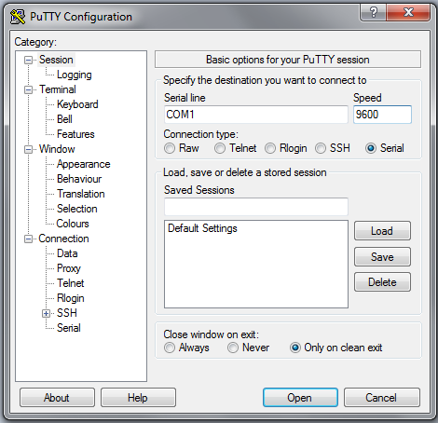
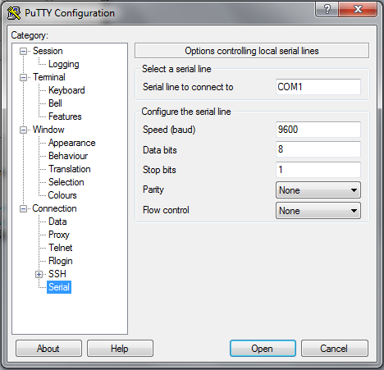
Use Putty to communicate with spart
Follow the picture to set putty in Serial mode.
Note that serial line number may not be COM1, follow the following steps to check:
Press win key, type “device manager”
Find the port number of “USB Serial port (COM X)” under “Ports”

